Slide 1
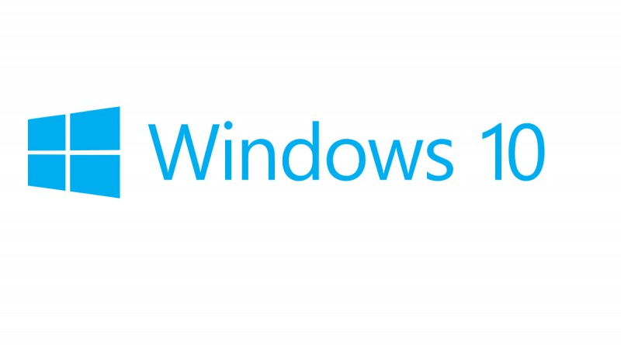
Presented by: _____________________
Comparison of editions and their features.

Slide 2
Editions available
Windows 10 pro.
Windows 10 Enterprise.
Windows 10 Home edition.
Windows 10 Education edition

Slide 3
Editions and their features
Productivity & user experience
Home
Pro
Enterprise
Education
Familiar and productive user experience
1
Continuum for phones
2
Cortana
3
Windows Ink
Start Menu and Live Tiles
Tablet Mode
4
Voice, pen, touch, and gesture
Microsoft Edge
Home SKU. MDM requires an MDM product such
Pro for
Home
Pro
Enterprise E3
Enterprise E5
Full
-volume encryption
Workstations
service. Sold separately.
Windows 10 LTSC Access
11.
Requires Azure AD for identity management. Sold
company resources and portals. Requires Office
by region and device.
12
Windows Analytics Device Health
Enterprise search
Intelligent security
| Advanced security, powered by cloud intelligence, that proactively protects your business.
Additional offerings available
1.
Windows Hello for Business with biometric
◔
◑
◑
◕
authentication requires specialized hardware,

Attack surface reduction
such as a fingerprint reader, illuminated IR sensor,
◑
◑
◑
◕

or other biometric sensors, depending on the
Next
-generation protection
authentication method.

Endpoint detection and response
-based key
2.
Requires TPM 1.2 or greater for TPM

protection.
Automatic investigation and remediation
3.
Windows Information Protection requires either

Security posture
MDM or System Center Configuration Manager to
manage settings. Sold separately.

Cross
-platform extensibility and integration
4.
This is the right to purchase not the capability




Multifactor authentication and biometrics
1
itself
◕
5.
Not all MDM capabilities are available in the

Credential protection
◔
◑
◑
◕

2
-party solutions,
as Microsoft Intune or other third
sold separately.




Data loss prevention
3
6.
Requires Azure AD for automatic MDM
enrollment. Requires Microsoft Intune for
Simplified updates
| Tools and insights IT can trust to simplify deployment and updates, freeing resources to drive more business value.
Blocking Status page. Sold separately.





Windows as a service
party MDM
7.
Requires Microsoft Intune or third-
14
Windows 10 commercial
for Windows IoT and Education
products
Mobile Application Management (MAM)
17
11
-V)
-in features that help employees collaborate and work efficiently.
edition comparison
device
Flexible management
Enhanced productivity
Windows Update for Business
Windows Analytics Upgrade Readiness
Windows Analytics Update Compliance
Windows 10 Supplemental Servicing Access
Mobile device management (MDM)
Windows Autopilot
Kiosk mode
Microsoft Store for Business
Manage user experiences
Resilient File System, SMB Direct, and Persistent Memory
Microsoft User Experience Virtualization (UE
Windows Timeline
Microsoft Edge
Cortana
Windows Ink
3D in Windows 10
Hybrid Azure AD Join
Windows 10 Subscription Activation
Microsoft Application Virtualization (App
15
7
16
13
| Comprehensive endpoint management that supports traditional, cloud, or hybrid IT on your terms.
6
8.
Available in select markets. Functionality and apps
may vary by region and device
9.
non
-volatile memory modules (NVDIMM)
required
10.
Requires Azure AD and Microsoft Intune, sold
separately.
separately.
12.
Requires either App-
V Server (available at no
additional cost as part of Windows 10 Assessment
and Deployment Kit) or System Center
Configuration Manager (sold separately).
13.
Requires Bing for business to search across
365 subscription, sold separately, to search across
OneDrive for Business and SharePoint locations.
14.
Shows up to 30 days of past activities done on
table and mobile phone when users are signed
into their Microsoft accounts.
15.
Available in select markets; experience may vary
16.
Touch capable device required. Pen accessory sold
separately.
17.
Remix 3D catalog available in select markets.
Experience may vary by region and
.















4







5
◑












8




◑
◑


9



10






-V)




| An intuitive experience with built































Slide 4
Security
Home
Pro
Enterprise
Education
Delivers critical security capabilities, system and app updates, and the compatibility you
need to help secure your devices and infrastructure from modern threats
Windows Hello⁹
10
Windows Hello Companion Devices
11
Windows Information Protection
12
Device encryption
13
BitLocker
14
Credential Guard
Device Guard
Trusted Boot
16
Windows Device Health Attestation service

Slide 5
Recommendations
I would advice you to settle for the Enterprise edition because of its features especially on security since most businesses need to be assured of data security and user security.
Today most businesses are cross-platform based hence Enterprise edition for windows 10 suites the spot for both mobile and desktop compatibility with all features available.

Slide 6
Questions?

Slide 7

Thank You…..

